Slide 1
Capitalism and Crisis
Erik Chevrier
www.erikchevrier.ca

Slide 2
Building Real Utopias (Erik Olin Wright)
- It fails and a new system is needed
- Ruptural (revolutionary)
- Interstitial (build alternatives)
- Symbiotic (social democratic, reformist)
- Nowtopia
- Non-reformist reforms
*Global billionaires transcend nation states and develop a world of techno-feudalism/fascism

Slide 3
Envisioning Real Utopias Olin Wright, E. (2010) Envisioning Real Utopias, Verso
How to transform the political/social/economy
- Theory of social reproduction
- Theory of gaps, cracks and contradictions within the process of social reproduction
- Theory of underlying dynamics and trajectory of unintended social change
- Theory of collective actors, strategies and struggles
Theories of social change must take into account these three factors:
Desirability
Viability
Achievability

Slide 4
Looking for Solutions
The Great Transformation
  History of economic practices and institutional patterns
    Markets – market pattern
    Reciprocity – cemetery
    Re-distribution – autocracy
    Householding – Oikonomia vs chrematistics
  Fictitious commodities
    Land
    Labour
    Money

Slide 5
Chrematistics – art of acquisition – limitless accumulation unnatural and problematic
Oikonomia – management of the household – true form of an economy
Problem with Chrematistics:
- Limitless accumulation
- Conversion of nature into commodities

Slide 6
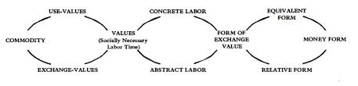
Marx Dialectic From Capital Volume 1

Slide 7
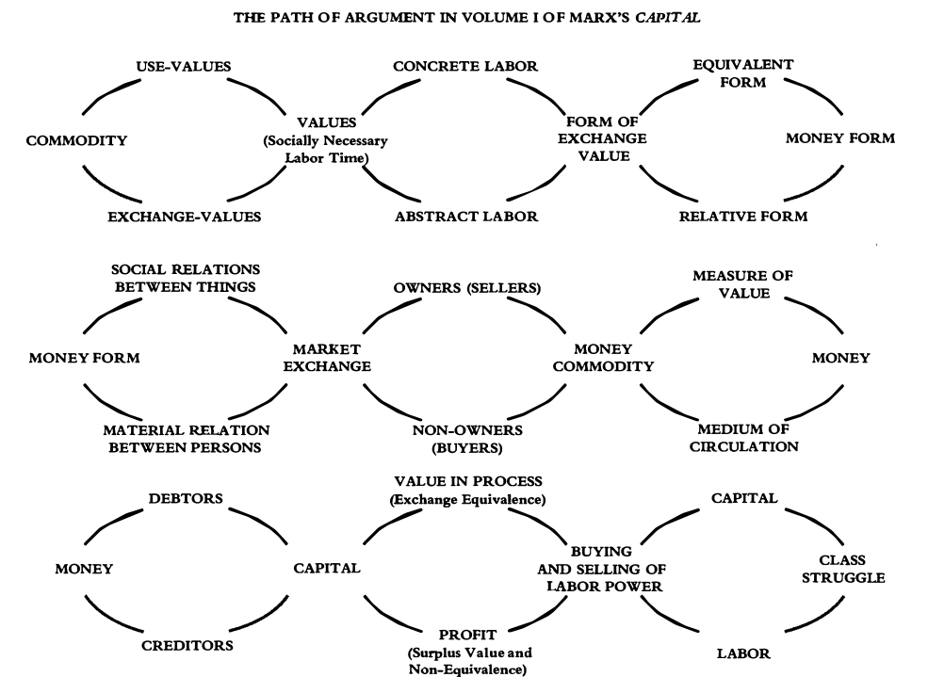
Marx Dialectic From Capital Volume 1

Slide 8
Limitless Accumulation
C-C
C-M-C
M-C-M’
M(LP-MP-RM)-C-M’
M-M’

Slide 9
Marx Dialectic From Capital Volume 1

Slide 10
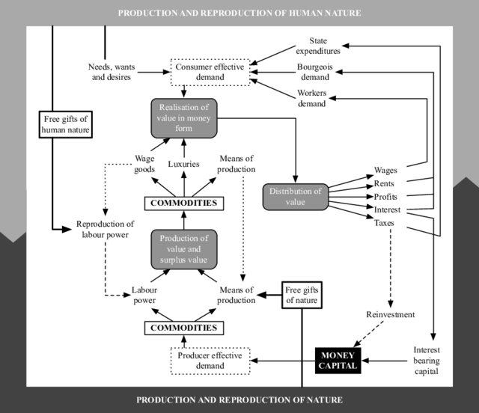

Slide 11
Many Types of Value
Social capital
Financial capital
Living capital
Intellectual capital
Experiential capital
Spiritual capital
Cultural capital
  Roland, E.C., Lanuda, G. (2013) Regenerative Enterprise. Optimizing for Multi-Capital Abundance

Slide 12
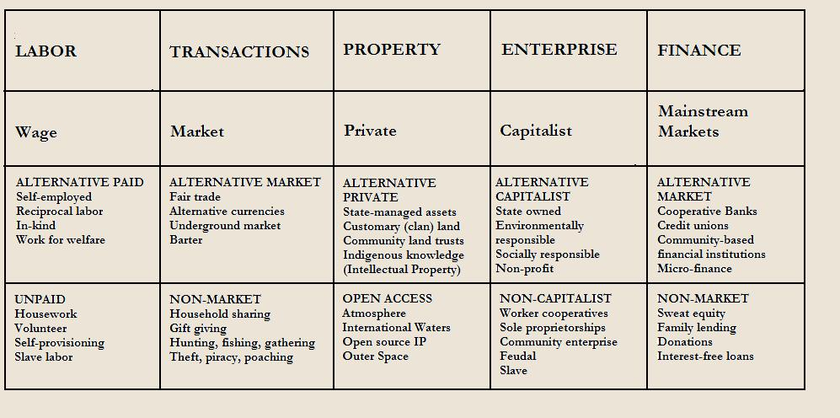
Gibson Graham – Take back the Economy Gibson-Graham, J.K., Cameron, J., Healy, S. (2013) Take Back the Economy: An Ethical Guide for Transforming Communities, University of Minnesota Press

Slide 13
Other Theories to Transform Capitalism
Social Movements
Degrowth
Decolonize
Socialism
Anarchism
Communism
Economic Heterodox
Diverse Economies
Social Reproduction
Social Solidarity Economy
Other
Techno-feudalism
Oligarch dictatorships

Slide 14
Discussion
What are ways we can transform the political/social/economic system?

